Slide 1
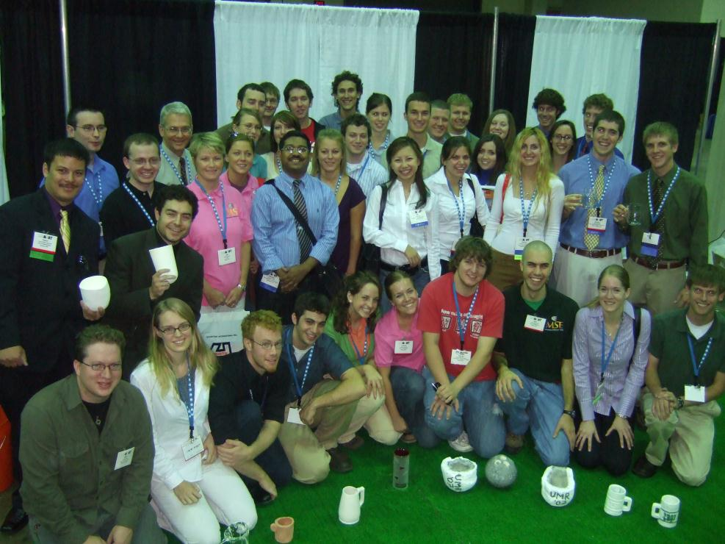
The Student Program for
Materials Science and Engineering

Slide 2
WHAT IS MATERIAL ADVANTAGE?
A program specifically created for undergraduate and graduate students enrolled in materials science engineering programs at universities worldwide, to combine the individual benefits of four societies into one great advantage to students at one low-cost ($30) membership fee

Slide 3
WHO ARE THE PARTNERS OF MATERIAL ADVANTAGE?
The American Ceramic Society (ACerS)
The Association for Iron & Steel Technology (AIST)
ASM International® (ASM)
The Minerals, Metals, & Materials Society (TMS)

Slide 4
WHO RUNS THE MATERIAL ADVANTAGE PROGRAM?
The four Partner Societies, with guidance from the Material Advantage Committee (MAC).
The MAC is comprised of four volunteer members from each partner society to guide the program.
One staff representative from each partner society for program administration.

Slide 5
Staff Representative:
Yolanda Natividad (ynatividad@ceramics.org)
Material Advantage Responsibilities
Material Advantage Website/Special Programs

Slide 6
Staff Representative:
Courtney Shaffer (cshaffer@aist.org)
Material Advantage Responsibilities
Marketing and Promotion

Slide 7
Staff Representative:
Drew Fleming (students@asminternational.com)
Material Advantage Responsibilities
Chapter Administration

Slide 8
Staff Representative:
Bryn Simpson (bsimpson@tms.org)
Material Advantage Responsibilities
Membership/Database Management

Slide 9
WHO ELSE IS A MEMBER OF MATERIAL ADVANTAGE?
There are currently over 5,000 individual members of Material Advantage
Members are from 450+ universities around the world
There are currently 95+ active Material Advantage Chapters

Slide 10
WHY BECOME A MEMBER OF MATERIAL ADVANTAGE?
Stay up-to-date on partner society updates about events and activities
Get the needed edge in the global job market
Learn and sharpen skills necessary for a successful engineering career
Develop leadership skills
Access a broad spectrum of knowledge

Slide 11
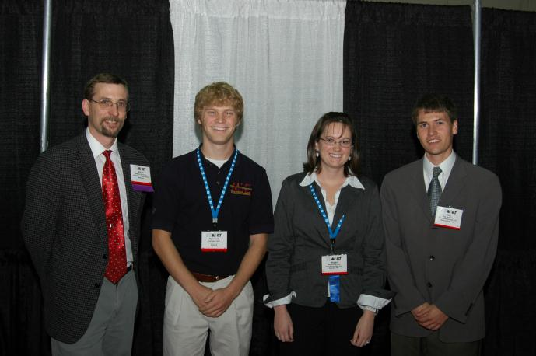
WHAT OPPORTUNITIES DOES MATERIAL ADVANTAGE OFFER
Networking
Information Resources
Financial
Future

Slide 12
Networking
Take advantage of all networking opportunities at MS&T and individual partner conferences and meetings
Meet future employers and learn about career possibilities in the materials community
Meet fellow students who will make a difference now and in your future

Slide 13
Information Resources
Electronic access to all four monthly magazines: American Ceramic Society Bulletin, Iron & Steel Technology, Advanced Materials & Processes, and JOM.
Material Advantage Newsletter
Online access to publications, technical papers, and reference sources

Slide 14
Financial
Access to over $800,000 in scholarships and grants annually
Discount on conference registration fees
Win cash prizes in Material Advantage and partner society contests
Travel grants for chapters to MS&T and partner society conferences and events
Earn money as a session monitor at conferences

Slide 15
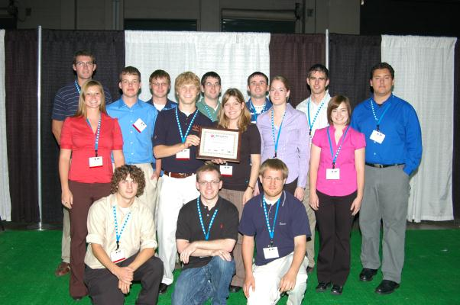
Future Opportunities
One year complimentary membership to each partner society following graduation
Internship and employment opportunity Websites offered by each partner
A lifetime of success

Slide 16
WHAT DOES A MATERIAL ADVANTAGE CHAPTER DO?
Meet other engineering students in your school and at conferences
Start forming a network of contacts now
Enter Material Advantage contests and challenges
Mentor K-12 future materials science engineers
Travel grants available to chapters

Slide 17
WHAT DOES A MATERIAL ADVANTAGE CHAPTER DO? (cont.)
New Chapters receive $150 start-up funds
Annual rebate of $5 per active member
Hold meetings and activities, technical or social
Recruit new members
Chapter recognition through Material Advantage awards and challenges: Chapters of Excellence, Membership Challenge.

Slide 18
WHAT IS MS&T?
Materials Science & Technology Conference and Exhibition
Materials conference organized by the four partner organizations of Material Advantage
Held annually in the Fall
Maximum opportunities for Material Advantage members for networking, learning, and fun

Slide 19
WHAT’S AT MS&T FOR STUDENTS?
Chapter Officer Workshop for chapter officers
MA Contests:
Undergraduate Speaking Contest
Undergraduate and Graduate Poster Contests
Ceramic Mug Drop Contest
Ceramic Disc Golf Contest
Career Development Session
Student Networking Mixer
Visit http://www.matscitech.org/students/ for more details

Slide 20
WHO SHOULD I CONTACT IF I HAVE QUESTIONS ABOUT MATERIAL ADVANTAGE?
Any of the four partner society staff
representatives can answer your questions:
Yolanda Natividad (ACerS) at 614-794-5827
Courtney Shaffer (AIST) at 724-814-3096
Drew Fleming (ASM) at 440-338-5151 x5652
Bryn Simpson (TMS) at 724-814-3172

Slide 21
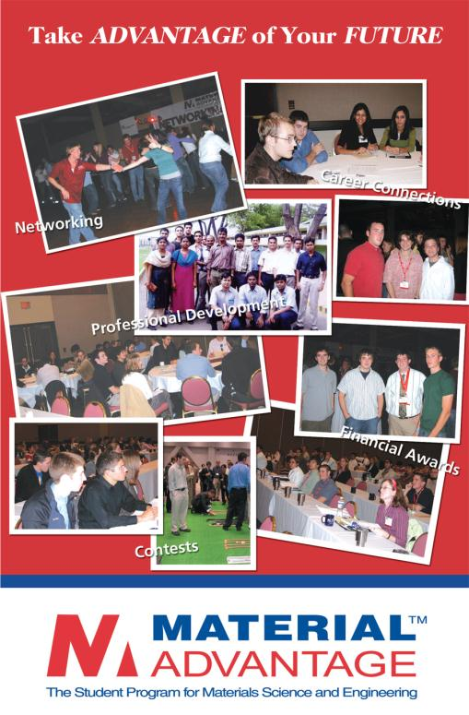
You will see the value of membership in Material Advantage through the many opportunities for your personal development and the long-term benefits of building a foundation for your career right now!

Slide 22
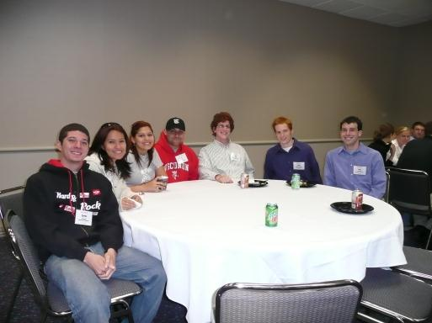
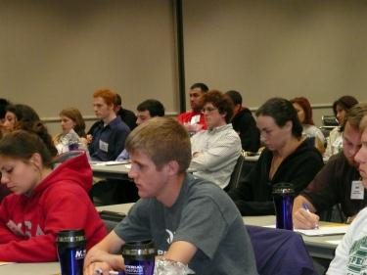
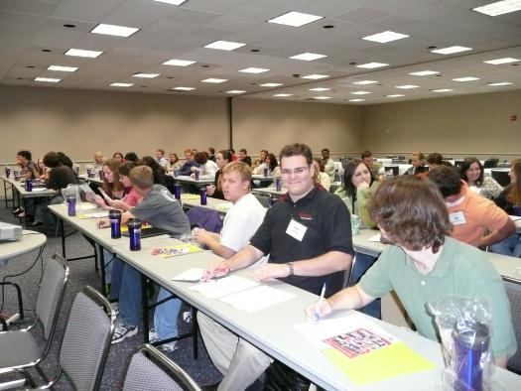
For more information, visit the
Material Advantage website at www.materialadvantage.org.

